Slide 1
Mechanical Lecture -1

Slide 2
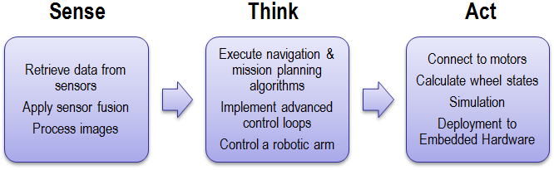
Machines V/S Robots

Slide 3
Basic Parts of a Robot

Slide 4
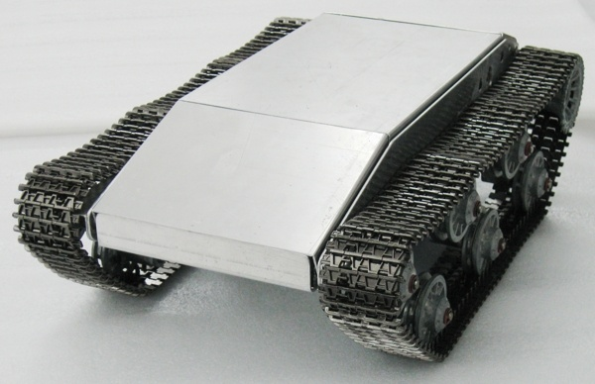
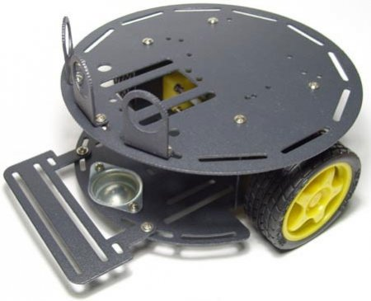
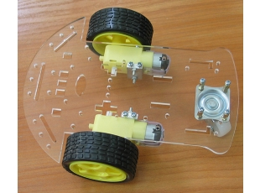
CHASSIS
To provide a frame for the robot.

Slide 5
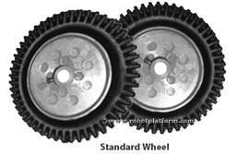
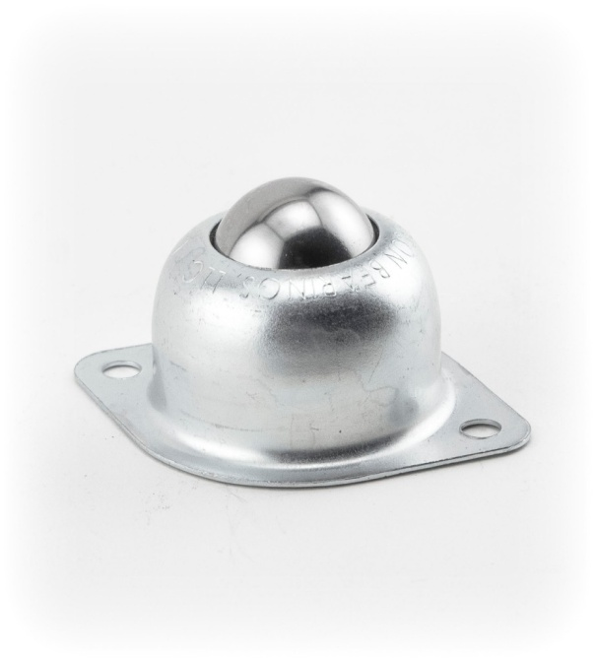
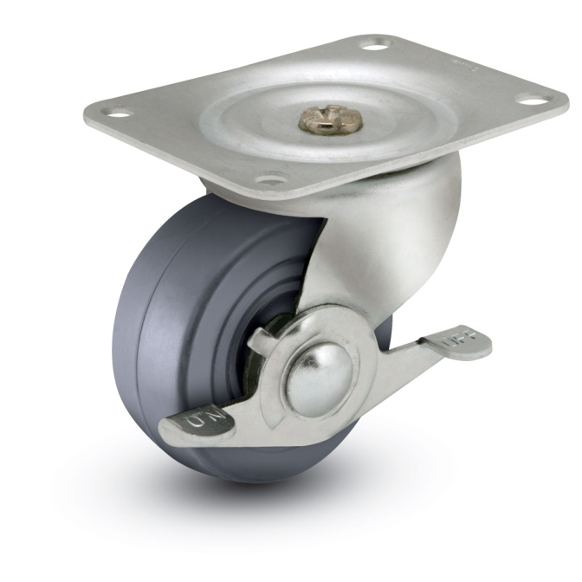
WHEELS
Standard Wheel
Castor Wheels

Slide 6
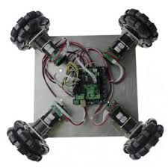
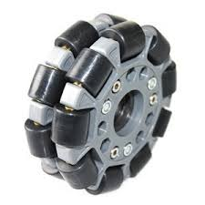
Omni wheels
Can move in many directions
wheels with small discs around the circumference which are perpendicular to the rolling direction. The effect is that the wheel will roll with full force, but will also slide laterally with great ease.

Slide 7
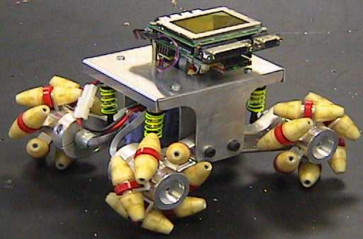
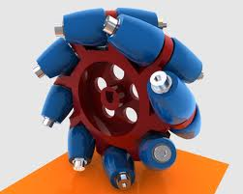
Mecanum wheels
It can move a vehicle in any direction.
It is a conventional wheel with a series of rollers attached to its circumference.

Slide 8
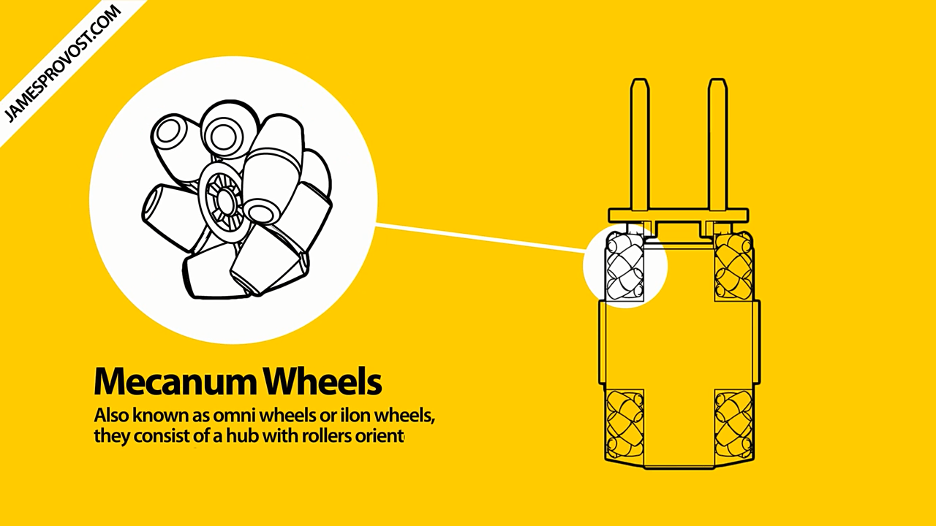

Slide 9
ACTUATOR

Slide 10
What is an actuator?
An actuator is something that converts energy into motion.
Actuator take fluid, electric or some other source of power and convert it through a motor, piston or other device to perform work
Actuator may rotate an object ,open or close a device or push a surface up or down , but they always put something into motion

Slide 11
Hydraulic Actuators
consists of a cylinder or fluid motor that uses hydraulic power to facilitate mechanical operation
a hydraulic actuator can exert considerable force, but is limited in acceleration and speed.

Slide 12
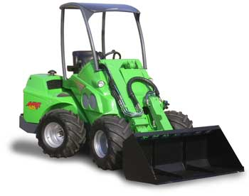
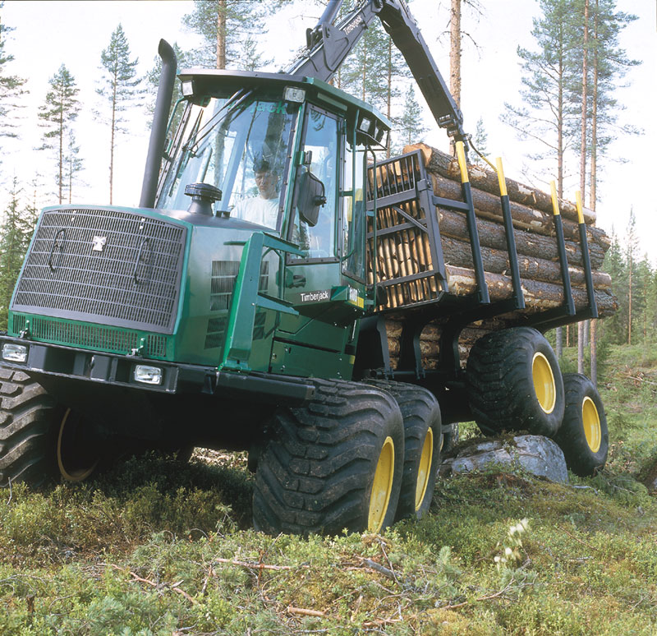
Examples

Slide 13
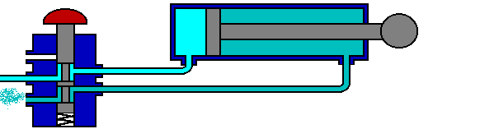
Pneumatic Actuators
A pneumatic actuator converts energy (typically in the
form of compressed air) into motion.

Slide 14
Motors
DC MOTORS
STEPPER MOTORS
SERVO MOTORS
WORM GEAR MOTORS

Slide 15
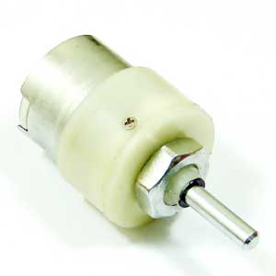
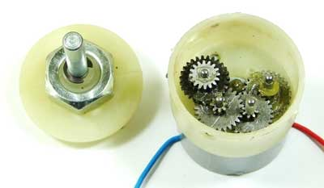
DC Motor
Most efficient at rated voltage
High power to weight ratio
No feedback mechanism installed
Using gears speed and torque are adjusted

Slide 16
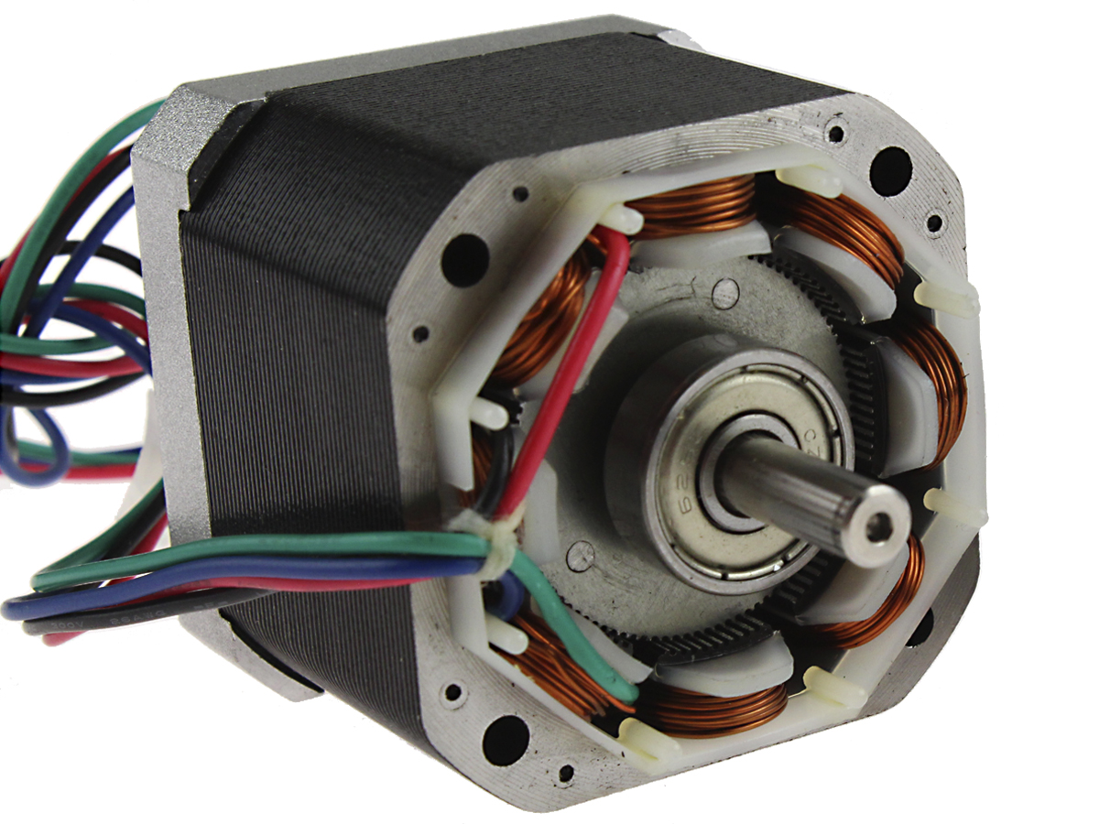
Stepper Motor
Designed to maximize holding torque
Accurate but slow
No feedback mechanism installed
Ease of control
Completes a rotation in steps

Slide 17
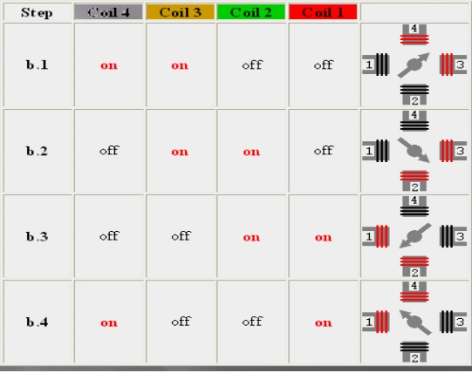

Slide 18
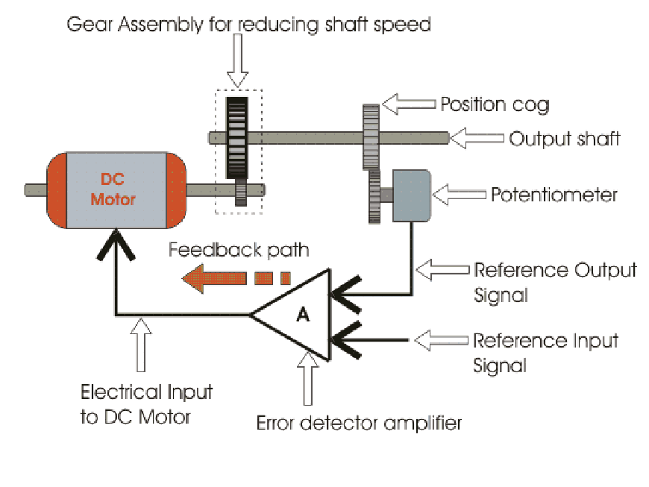
Servo Motor
DC motor with inbuilt feedback mechanism
More accurate than stepper motor
Cannot rotate more than 180 degrees
Feedback ensures that shaft rotates accurately

Slide 19
Servo motor mechanism
The motor is paired with some type of encoder to provide position and speed
Only the position is measured and measured position of the output is compared to the command position, the external input to the controlled feedback.
If the output position differs from that required, an error signal is generated which then causes the motor to rotate in either direction, as needed to bring the output shaft to the appropriate position. As the positions approach, the error signal reduces to zero and the motor stops.

Slide 20
Worm Gear motor
A worm drive can reduce rotational speed or allow higher torque to be transmitted.
Used by us to lift heavy loads.
Unidirectional power transfer

Slide 21
Drives

Slide 22
Differential Drive
Simplest and easiest to implement
It can also be 3 or 4 wheels drive
3 wheel drive has a free moving wheel accompanied with a left and right wheel . The two wheels are separately powered.
Generating a couple
Independent drives makes it difficult for straight line motion

Slide 23
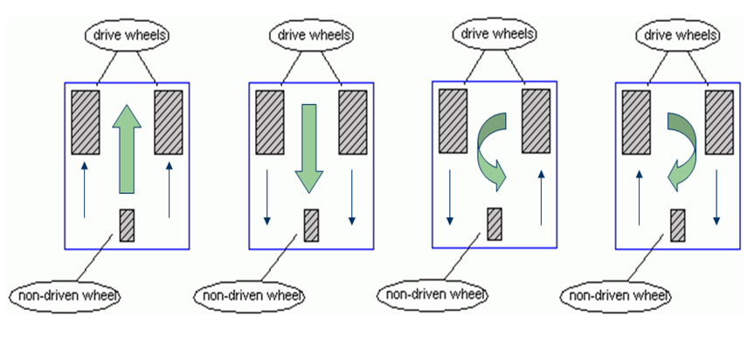

Slide 24
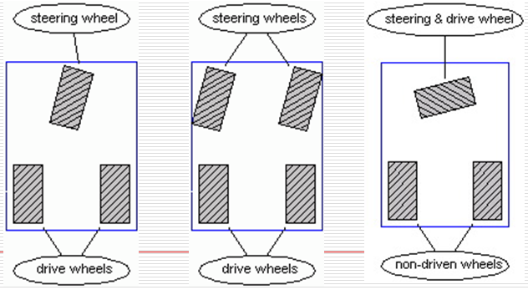
Steering
Can be 3 or 4 wheels
Using guiding wheels to steer the bot
Generally used in three wheel drive
Not effictive to take a very sharp turn

Slide 25
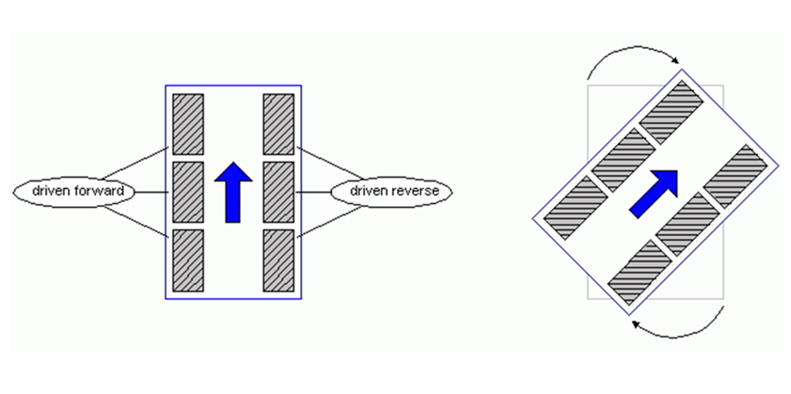
Skid Steer Drive
It is mostly used in tracked machines e.g. tanks. Also finds application in some four/ six wheeled robots
The left and right wheels are driven independently
Steering is accomplished by actuating each side at a different rate or in a different direction, causing the wheels or tracks to slip or skid, on the ground

Slide 26
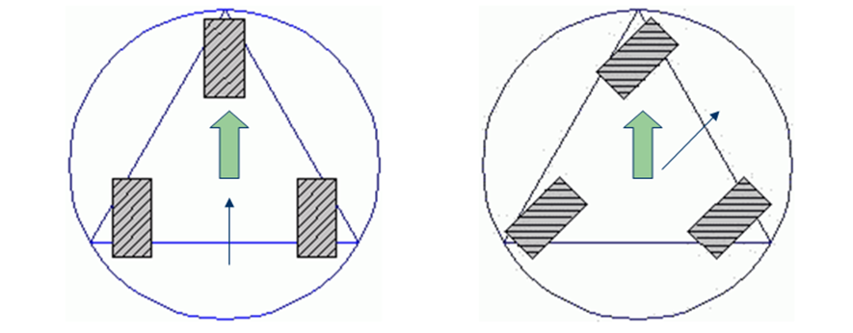
Synchronous Drive
It is made up of system of motors. One set of which drive the wheels and the other set turns the wheels in a synchronous Drive

Slide 27
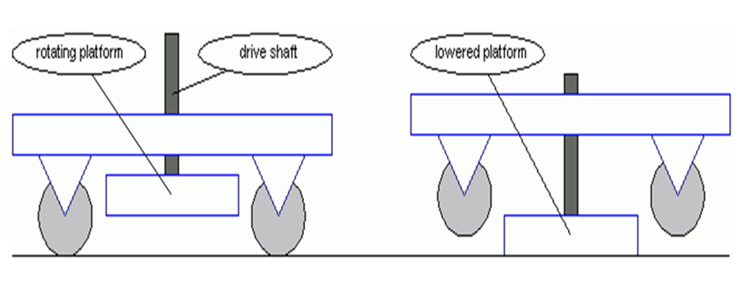
Pivot Drive
It is composed of a four wheeled chassis and a platform that can be raised or lowered and rotated.

Slide 28
Gears

Slide 29
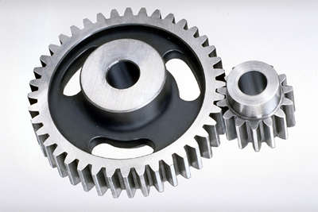
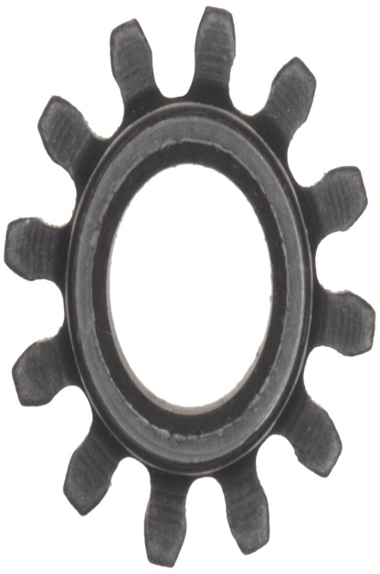
Spur Gears
Straight cut gears ,teeths are radial
Used to modify power from source(motor).
Main components of gearboxes
Maximum efficiency(upto 10%).
Teeths break easily

Slide 30
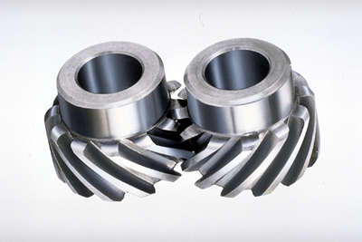
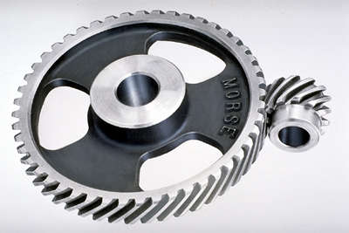
Helical gears
Teeths no parallel to axis
Smooth and noise free
Costly to manufacture
Less efficient than spur gears
Used in high speed applications

Slide 31
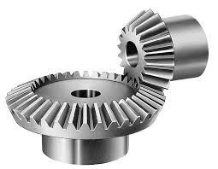
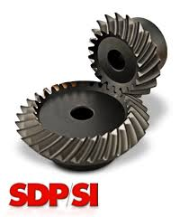
Bevel Gears
Main purpose is to transmit power at an angle(90 degree in most cases without reduction.
Two types – straight and helical

Slide 32
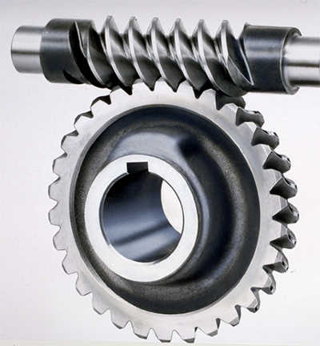
Worm Gear
Worm gear usually meshed up with spur or hellical gear.
High torque low speed gear ratio.
Unidirectional in terms of power transfer.(transmitted from worm to gear).
No back drivable

Slide 33
Gripping and lifting mechanisms

Slide 34
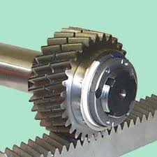
Rack And Pinion Gripper Mechanism
It involves an intensive use of “rack and pinion” gears.

Slide 35
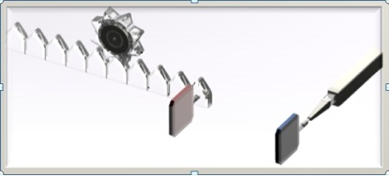
For this type of gripper we can have one part of the gripper as stationary and actuate the other, its movement being controlled by the direction of rotation of the motor.

Slide 36
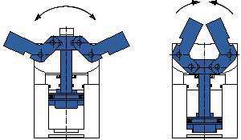
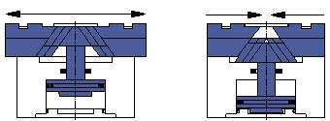
Angular
Parallel

Slide 37
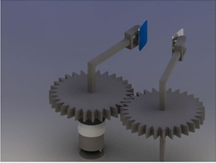
Another option with the grippers can be to move both the parts simultaneously using gears or wires and spool.

Slide 38
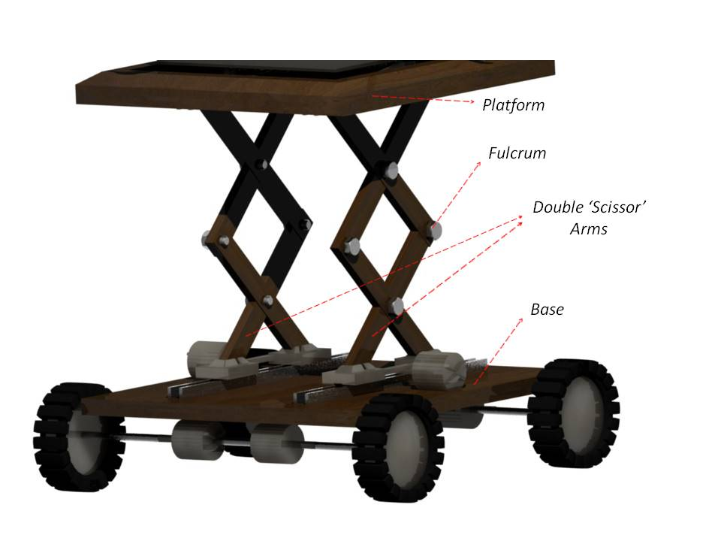
Scissor Lift Mechanism (Pneumatic)
In order to lift objects at a height, only the bot needs to extend itself. One of the mechanisms for this is “Scissor Lift”.
It can use motors
or pneumatic actuators.

Slide 39
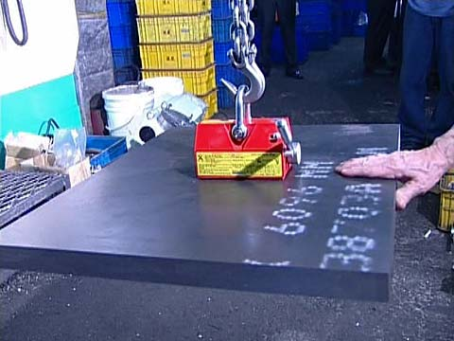
Hook Lowering Mechanism
Hook lowering mechanism can be used to lift/pick objects that are provided with a handle. You just need a DC motor to control the motion of the hook.
You can again make use of rack and pinion gears to control the downward and upward motion of the hook.

Slide 40
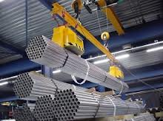
Electromagnetic Lifter
Electromagnets can be used to pick objects provided with a magnetic surface and are light. Switching on the power supply will help in lifting objects and switching it off will drop them.

Slide 41
Hydraulic Gripper
Hydraulic machines are machinery and tools that use liquid fluid power to do simple work. In this type of machine, hydraulic fluid is transmitted throughout the machine to various hydraulic motors and hydraulic cylinders and which becomes pressurized according to the resistance present. The fluid is controlled directly or automatically by control valves and distributed through hoses and tubes.
The popularity of hydraulic machinery is due to the very large amount of power that can be transferred through small tubes and flexible hoses, and the high power density and wide array of actuators that can make use of this power.
Now , in order to make the robot cheaper, you can always use syringes to supply liquid (generally water) .

Slide 42
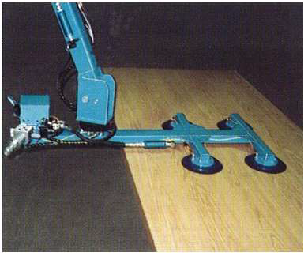
Vacuum Grippers
Vacuum power is used to create grip and so used to lift object.
Suction cups are very well suited for a wide variety of needs and circumstances. They can handle plate, paper, wood – practically any material.

Slide 43
THANK YOU

